Slide 2
Absence of Copyright
This slideshow contains photos, diagrams, and information, some of which were attained through internet searches of public websites. The author of this presentation does not own the copyright on this information, so this slideshow is for personal use only—not for sale or profit. Please utilize it to seek the Lord and grow in your knowledge of His Word and ways.

Slide 4
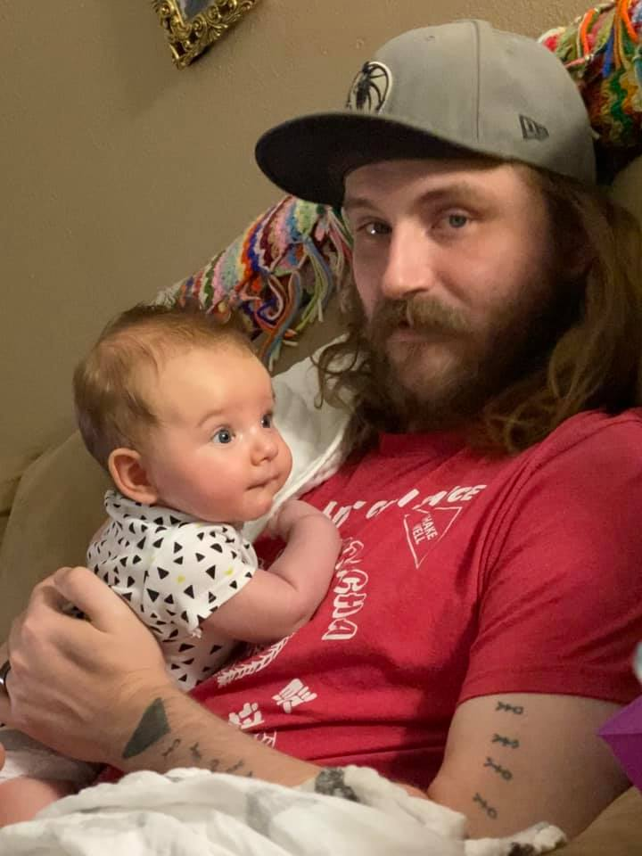
I guess I should acknowledge that my grandson Noah has a father... Meet my son, Josh.
(please note that Josh is wearing a Dallas Mavericks cap... It must run in the family!)

Slide 5
Prayer and Announcements
Sunday: 9:15 Fellowship
9:30 SS Master Class
10:30 Worship
Revelation Study available on our church website
www.faithprinceton.org
Email questions and comments to
pastor@faithprinceton.org

Slide 7
END HERE JULY 22, 2020
WEEK 11
BEGIN HERE JULY 29, 2020
Oswald Cambers, My Utmost for His Highest: July 28 Devotional
Notes:
July 28 Devotional
After Obedience – What?
By Oswald Chambers
And straightway He constrained His disciples to get into the ship, and to go to the other side.… — Mark 6:45-52
We are apt to imagine that if Jesus Christ constrains us, and we obey Him, He will lead us to great success. We must never put our dreams of success as God’s purpose for us; His purpose may be exactly the opposite. We have an idea that God is leading us to a particular end, a desired goal; He is not. The question of getting to a particular end is a mere incident. What we call the process, God calls the end.
What is my dream of God’s purpose? His purpose is that I depend on Him and on His power now. If I can stay in the middle of the turmoil calm and unperplexed, that is the end of the purpose of God. God is not working towards a particular finish; His end is the process — that I see Him walking on the waves, no shore in sight, no success, no goal, just the absolute certainty that it is all right because I see Him walking on the sea. It is the process, not the end, which is glorifying to God.
God’s training is for now, not presently. His purpose is for this minute, not for something in the future. We have nothing to do with the afterwards of obedience; we get wrong when we think of the afterwards. What men call training and preparation, God calls the end.
God’s end is to enable me to see that He can walk on the chaos of my life just now. If we have a further end in view, we do not pay sufficient attention to the immediate present; if we realize that obedience is the end, then each moment as it comes is precious.

Slide 8
Daily Bible Reading for July 28 (29)
Isaiah 8:11 - 22 NLT
Notes:
Isaiah 8:11‭-‬22 NLT
The Lord has given me a strong warning not to think like everyone else does. He said,
“Don’t call everything a conspiracy, like they do, and don’t live in dread of what frightens them.
Make the Lord of Heaven’s Armies holy in your life.
He is the one you should fear.
He is the one who should make you tremble.
He will keep you safe.
But to Israel and Judah he will be a stone that makes people stumble, a rock that makes them fall. And for the people of Jerusalem he will be a trap and a snare. Many will stumble and fall, never to rise again. They will be snared and captured.”
Preserve the teaching of God; entrust his instructions to those who follow me.
I will wait for the Lord , who has turned away from the descendants of Jacob. I will put my hope in him.
I and the children the Lord has given me serve as signs and warnings to Israel from the Lord of Heaven’s Armies who dwells in his Temple on Mount Zion.
Someone may say to you, “Let’s ask the mediums and those who consult the spirits of the dead. With their whisperings and mutterings, they will tell us what to do.” But shouldn’t people ask God for guidance? Should the living seek guidance from the dead?
Look to God’s instructions and teachings!
People who contradict his word are completely in the dark. They will go from one place to another, weary and hungry. And because they are hungry, they will rage and curse their king and their God. They will look up to heaven and down at the earth, but wherever they look, there will be trouble and anguish and dark despair. They will be thrown out into the darkness.

Slide 9
Revelation 6:12-17 The Sixth Seal—Terror
12 I looked when He broke the sixth seal, and there was a great earthquake; and the sun became black as sackcloth made of hair, and the whole moon became like blood; 13 and the stars of the sky fell to the earth, as a fig tree casts its unripe figs when shaken by a great wind. 14 The sky was split apart like a scroll when it is rolled up, and every mountain and island were moved out of their places.
Notes:
Newport calls this “THE THRESHOLD OF THE END” (189). He also notes that we have not ever experienced anything like this in human history, so it must refer to a future event. (Newport, 182)
The Day of the Lord
Old Testament imagery: “earthquakes” (Ezekiel 38:19ff.; Isa. 2:19; Hag. 2:6); “sun: blackened and “moon” like blood (Joel 2:31; Ezek. 32:7); “stars” falling like fig leaves in a winter gale (Isa. 34:4; Nah. 3:12); the “sky vanished like a scroll” (Isa. 34:4); “mountains” and “islands” moved (Ps. 114:4; Jer. 4:24).
“cosmic turmoil” (Newport, 190) Hal Lindsey thought all of this referred to a nuclear war and fallout. (The Late Great Planet Earth, 1970)
[compare Mark 13:24-27]
24 “But in those days, following that distress,
“‘the sun will be darkened,
and the moon will not give its light;
25 the stars will fall from the sky,
and the heavenly bodies will be shaken.’
26 “At that time people will see the Son of Man coming in clouds with great power and glory. 27 And he will send his angels and gather his elect from the four winds, from the ends of the earth to the ends of the heavens.

Slide 10
Revelation 6:12-17 The Sixth Seal—Terror
15 Then the kings of the earth and the great men and the commanders and the rich and the strong and every slave and free man hid themselves in the caves and among the rocks of the mountains; 16 and they said to the mountains and to the rocks, “Fall on us and hide us from the presence of Him who sits on the throne, and from the wrath of the Lamb; 17 for the great day of their wrath has come, and who is able to stand?”
Notes:
All men great and small are included!
Hide themselves in caves... SEE ISAIAH 2:19-22 “Men will go into caves of the rocks and into holes of the ground before the terror of the Lord and the splendor of His majesty, when He arises to make the earth tremble....” and they will cast away their idols of silver and gold when they go to hide!
Paradox: the wrath of the Lamb = lambs are usually gentle.
Wrath of God is already at work (Romans 1:18ff) but is also coming.
John 5:25-30 The Father gives judgment to the Son (vs 27 and He gave Him authority to execute judgment, because He is the Son of Man...”)
The great day of their wrath = see Joel 2:11, 31; Nahum 1:6; Malachi 3:2.
Joel 2:1‭-‬17 NASB
Blow a trumpet in Zion, And sound an alarm on My holy mountain! Let all the inhabitants of the land tremble, For the day of the Lord is coming; Surely it is near, A day of darkness and gloom, A day of clouds and thick darkness. As the dawn is spread over the mountains, So there is a great and mighty people; There has never been anything like it, Nor will there be again after it To the years of many generations. A fire consumes before them And behind them a flame burns. The land is like the garden of Eden before them But a desolate wilderness behind them, And nothing at all escapes them. Their appearance is like the appearance of horses; And like war horses, so they run. With a noise as of chariots They leap on the tops of the mountains, Like the crackling of a flame of fire consuming the stubble, Like a mighty people arranged for battle. Before them the people are in anguish; All faces turn pale. They run like mighty men, They climb the wall like soldiers; And they each march in line, Nor do they deviate from their paths. They do not crowd each other, They march everyone in his path; When they burst through the defenses, They do not break ranks. They rush on the city, They run on the wall; They climb into the houses, They enter through the windows like a thief. Before them the earth quakes, The heavens tremble, The sun and the moon grow dark And the stars lose their brightness. The Lord utters His voice before His army; Surely His camp is very great, For strong is he who carries out His word. The day of the Lord is indeed great and very awesome, And who can endure it?
“Yet even now,” declares the Lord , “Return to Me with all your heart, And with fasting, weeping and mourning; And rend your heart and not your garments.” Now return to the Lord your God, For He is gracious and compassionate, Slow to anger, abounding in lovingkindness And relenting of evil. Who knows whether He will not turn and relent And leave a blessing behind Him, Even a grain offering and a drink offering For the Lord your God? Blow a trumpet in Zion, Consecrate a fast, proclaim a solemn assembly, Gather the people, sanctify the congregation, Assemble the elders, Gather the children and the nursing infants. Let the bridegroom come out of his room And the bride out of her bridal chamber. Let the priests, the Lord ’ s ministers, Weep between the porch and the altar, And let them say, “Spare Your people, O Lord , And do not make Your inheritance a reproach, A byword among the nations. Why should they among the peoples say, ‘Where is their God?’ ”
Joel 2:28‭-‬32 NASB
“It will come about after this That I will pour out My Spirit on all mankind; And your sons and daughters will prophesy, Your old men will dream dreams, Your young men will see visions. Even on the male and female servants I will pour out My Spirit in those days. I will display wonders in the sky and on the earth, Blood, fire and columns of smoke. The sun will be turned into darkness And the moon into blood Before the great and awesome day of the Lord comes. And it will come about that whoever calls on the name of the Lord Will be delivered; For on Mount Zion and in Jerusalem There will be those who escape, As the Lord has said, Even among the survivors whom the Lord calls.

Slide 11
Revelation 7:1-3 The SEAL of the Living God
1 After this I saw four angels standing at the four corners of the earth, holding back the four winds of the earth, so that no wind would blow on the earth or on the sea or on any tree. 2 And I saw another angel ascending from the rising of the sun, having the seal of the living God; and he cried out with a loud voice to the four angels to whom it was granted to harm the earth and the sea, 3 saying, “Do not harm the earth or the sea or the trees until we have sealed the bond-servants of our God on their foreheads.”
Notes:
“four corners of the earth” = The expression found at Revelation 7:1 means all places on the earth. The general meaning - north, south, east, and west - is such that if you travel continuously around the globe in each direction, you will eventually come back to the place from which you started, thus covering the entire globe. “Four corners” is not a reference to a flat earth of some quadrangular shape. BTW the German translation has it as “the four ends of the Earth” in Italian the earth has “edges”, the Septuagint (the oldest Greek translation of the Old Testament has it as “pinions”. The Vulgate says “plagis” (open expanse of country/sea/sky/tract/region/quarter/zone/area)
The idiom ‘four corners’ is an English translation of the Hebrew word kanaph which is extremities. It can be translated in a number of ways, all of which mean ‘away from the centre’ (Jerusalem). If the meaning intended was ‘corner’ as in a square Earth, the term used would have been Paamouth.
Just like a compass. It has four main directions. No matter where you stand on the round earth, you still have four corners. North, south, east and west.
https://www.quora.com/What-does-four-corners-of-the-Earth-mean-in-the-Bible
“four winds” = Matthew 24:31 ESV And he will send out his angels with a loud trumpet call, and they will gather his elect from the four winds, from one end of heaven to the other.
Note: Hal Lindsey’s Dispensational View: believed Revelation prophesied of four major spheres of geographical, political power: (1) Russia with its allies, (2) China with other nations of the Orient, (3) Egypt with other Middle East countries, (4) an alliance of Western European nations (a revived form of the ancient Roman Empire ruled by the Antichrist). He believed Israel would be re-established as God’s covenant people and the USA wouldn’t be around at the end.

Slide 12
Revelation 7:1-3 The SEAL of the Living God
2 ...having the seal of the living God;
3 saying, “Do not harm the earth or the sea or the trees until we have sealed the bond-servants of our God on their foreheads.”
The seal of the Living (loving) God = mark of...
Ownership
Protection
Loyalty
Notes:
Revelation 6 speaks of the seven “seals” on the scroll that must be opened.
Revelation 7:2-3 speak of the “seal of the Living God”
The Same word is used in both places:
Noun in vs. 2: σφραγῖδα, from : σφραγίς seal: a seal, signet ring, the impression of a seal, that which the seal attests, the proof. Verb in vs. 3: σφραγίσωμεν: we shall have sealed V-ASA-1P Definition: to seal Usage: I seal, set a seal upon., i.e. to attest ownership, authorizing (validating) what is sealed. ("to seal") signifies ownership and the full security carried by the backing (full authority) of the owner. "Sealing" in the ancient world served as a "legal signature" which guaranteed the promise (contents) of what was sealed.
Seal = mark of [CONTRAST with MARK OF THE BEAST Rev 13:16-17]
1. ownership…
Ephesians 1:13-14 In Him, you also, after listening to the message of truth, the gospel of your salvation—having also believed, you were sealed in Him with the Holy Spirit of promise, who is given as a pledge of our inheritance, with a view to the redemption of God’s own possession, to the praise of His glory.
2. protection…
out of the smoke came locusts upon the earth, and power was given them, as the scorpions of the earth have power. They were told not to hurt the grass of the earth, nor any green thing, nor any tree, but only the men who do not have the seal of God on their foreheads. And they were not permitted to kill anyone, but to torment for five months; and their torment was like the torment of a scorpion when it stings a man. And in those days men will seek death and will not find it; they will long to die, and death flees from them.
3. Loyalty… won’t get mark of the beast =
Revelation 16:2 NASB So the first angel went and poured out his bowl on the earth; and it became a loathsome and malignant sore on the people who had the mark of the beast and who worshiped his image.
Revelation 19:20 And the beast was seized, and with him the false prophet who performed the signs in his presence, by which he deceived those who had received the mark of the beast and those who worshiped his image; these two were thrown alive into the lake of fire which burns with brimstone.
Revelation 20:4-6 Then I saw thrones, and they sat on them, and judgment was given to them. And I saw the souls of those who had been beheaded because of their testimony of Jesus and because of the word of God, and those who had not worshiped the beast or his image, and had not received the mark on their forehead and on their hand; and they came to life and reigned with Christ for a thousand years. The rest of the dead did not come to life until the thousand years were completed. This is the first resurrection. Blessed and holy is the one who has a part in the first resurrection; over these the second death has no power, but they will be priests of God and of Christ and will reign with Him for a thousand years.
OT IMAGERY: Ezekiel 9:3-6 ³ Then the glory of the God of Israel went up from the cherub on which it had been, to the threshold of the temple. And He called to the man clothed in linen at whose loins was the writing case. ⁴ The Lord said to him, “Go through the midst of the city, even through the midst of Jerusalem, and put a mark on the foreheads of the men who sigh and groan over all the abominations which are being committed in its midst.” ⁵ But to the others He said in my hearing, “Go through the city after him and strike; do not let your eye have pity and do not spare. ⁶ Utterly slay old men, young men, maidens, little children, and women, but do not touch any man on whom is the mark; and you shall start from My sanctuary.” So they started with the elders who were before the temple.

Slide 13
Revelation 7:4-8 The 144,000
4 And I heard the number of those who were sealed, one hundred and forty-four thousand sealed from every tribe of the sons of Israel:
5 from the tribe of Judah, twelve thousand were sealed, from the tribe of Reuben... Gad... 6 Asher... Naphtali... Manasseh... 7 Simeon... Levi... Issachar... 8 Zebulun... Joseph... Benjamin, twelve thousand were sealed.
Notes:
Vs 4: SEALED 144,00 from the Tribes of Israel?
144,000 = 12 x 12,000
Interpretations:
FIGURATIVE: Represents complete number of the people of God (the whole church)
DISPENSATIONALISM: Jewish believers converted after the rapture who become evangelists during tribulation. [multitude in vv 9-17 are Gentiles they convert]
HISTORICAL: either church as “spiritual Israel” or “national, physical Israel”
Problem: Israel not set up in tribal separations of geography or bloodline. Not all tribes represented. (Dan) Teachings of Paul on True Israel (see Rom. 2:28-29; Gal. 3:29; 6:16; Phil. 3:3; 1 Pet. 1:1; 2:9).
All the people of God need to be sealed, not just Israel or Jewish believers. In vs. 3 “bond-servants of God” used throughout the book for all the redeemed (Rev 2:20; 11:18; 19:2, 5; 22:3, 6).

Slide 14
Revelation 7:4-8 The 144,000
Judah comes first instead of Reuben
Sons of Joseph = Manasseh and Ephraim
Omitted = Tribe of Dan
Included = Tribe of Levi
Notes:
Omission of Dan =
Early church felt Antichrist would come from tribe of Dan (from Irenaeus, Bishop of Smyrna, AD 130-202)
Jewish teachers and early Christian fathers: Dan represents immorality and idolatry (Judges 18:16-19; 1 Kings 12:29-30)
So the king (Jeroboam) consulted, and made two golden calves, and he said to them, “It is too much for you to go up to Jerusalem; behold your gods, O Israel, that brought you up from the land of Egypt.” He set one in Bethel, and the other he put in Dan. Now this thing became a sin, for the people went to worship before the one as far as Dan. (1 Kings 12:28-30 NASB)
Tribe of Levi =
not counted in Pentateuch for inheritance because called as priests and levites
No need for a priestly tribe because Jesus is eternal high priest (Hebrews 4-5, etc.) ???

Slide 15
END HERE JULY 29, 2020
WEEK 12
BEGIN HERE AUGUST 5, 2020

